Slide 1
LGEID Process Standard
LGE Internal Use Only
Carry In Service
Welcoming/
Greeting
Y
Queue
Card
SE
Assignment
Repair
Receiving
Ask for
symptom
Product
Inspection
Repair Guide (judging charged or
free repair and notifying result
START
CRO, Offline
CRO, Offline
CRO, Offline
SE, GSFS
SE, Offline
SE, Offline
Repair?
Entering
Result/Cancel
N
Work Order
Filling
END
N
Entering incomplete
Repair result
Purchase
Accessories?
Y
Defective Return
End User
N
SE, Leader
GSFS
Y
D/R? or possible to repair
Queue
Card
CRO,
Offline
Y
Parts
Robbing
Y
N
Discontinue
Negotiation
Direct
Order
Y
N
Robbing
Possible?
ETA >
7 days
Y
Part Receive
Management
Purchase Order
Management
N
Part Discontinue?
Stock Available?
Parts
Owned?
ASC Labor
Charge Adj
ASC/DSC
Parts Receiving
Part Rental
Management
N
Parts request
to Admin
N
Y
Y
Product
Storing
Print
Work Order
Completed
Product
Repair
Use Parts
Collection
N
Y
Y
Discount
Approval
> 30 Days
Remind
Customer
N
N
Customer
take unit?
END
N
Use Parts?
Y
Y
Collecting
Bills
Y
N
Discount
Request
Long Stay
Handling
Y
N
N
Explain “3H”
(What, Why, How)
Work Order
Filling
Income
Collection
Entering
Repair Result
Customer
Sign
Print
Facture
S/N Sticker
Collection
Y
In WTY?
SE, Offline
SE, Offline
SE, Offline
SE, Offline
In WTY?
SE, Offline

Slide 2
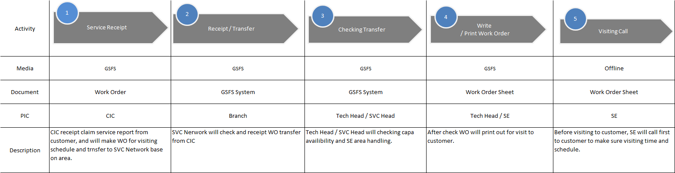
LGEID Process Standard
LGE Internal Use Only
Receipt Work Order
Service
Receipt
Receipt/
Transfer
Checking
Transfer
Y
Y
Y
Write
Work Order
Visiting
Call
CIC, GSFS
Leader, GSFS
N
Distribute To SE?
SE on the way?
Claim
Reject
N
N
Print
Work Order
N
Change Schedule?
Leader, GSFS
Y
Reverse
Claim Mgt (*)
Re Appointment
to Customer
Leader, Offline

